Slide 1
ANZ Virtual Internship
Predictive Analytics
[Client Name]

Slide 2
Index
Dataset Analysis
Data Preparation
Data Correlation
Data Visualization
Linear Regression
Decision Tree
Results

Slide 3
Dataset Analysis
The dataset contains information of 100 hypothetical customers for 3 months.
Below distribution shows pay and payments of customers (in detail) from 29th July to 30th October.
Pay for each customer is constant. However, paycount varies from 1-14. Hence, calculation of annual salaries by grouping customers accounts to their payments is done.

Slide 4
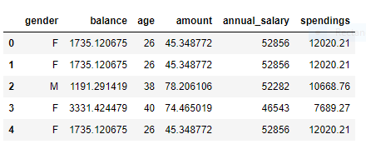
Data Preparation
Calculation of annual salaries of customers based on 3 categories: (a) Weekly (b) Fortnightly and (c) Monthly.
Attributes used for prediction are gender, age, balance, amount and spendings.
Here, spendings is a feature engineered attribute calculated by adding all debit transactions.

Slide 5
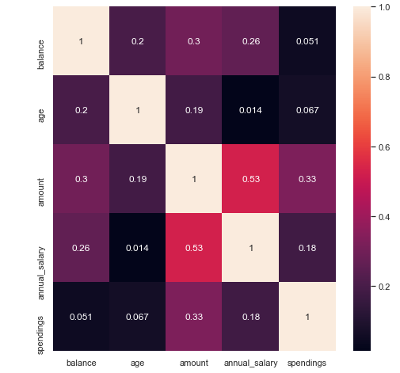
Data Correlation
annual_salary feature has significant correlations spendings.
balance and spendings(feature engineered) also correlate to annual_salary, but lesser than amount.
age cannot be used for prediction as its correlation is not significant.
Data points on scatter plot do not show any pattern. F-gender cannot be well distinguished with M-gender. Hence, gender cannot be used for prediction.

Slide 6
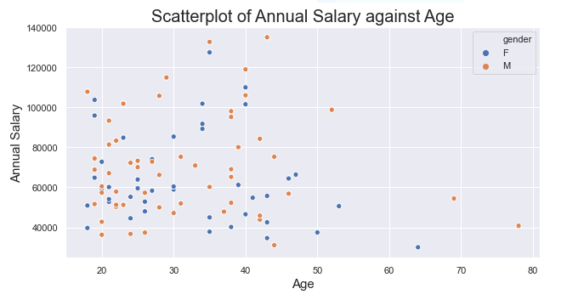
Data Visualization

Slide 7
Linear Regression
Model used: LinearRegression from sklearn package.
The accuracy score of the model is 0.67 which is not good.
The scatter plot shows how well the model is doing. The variance between actual values and predicted values is very high.
R2 score = 0.67
Mean Absolute Error = 10096.884
Mean Absolute Error = 180017139.93

Slide 8
Decision Tree
Model used: DecisionTreeRegressor from sklearn package.
Percentile scores for decision tree regression were used.
The accuracy score of the model is 0.75 which is not good.
The scatter plot shows how well the model is doing. The variance between actual values and predicted values is very high.
R2 score = 0.75
Mean Squared Error = 179.284
Mean Absolute Error = 8.154

Slide 9
Results
The features selected did not produce a good model to predict annual salary of the customers.
As, we can see that accuracy score of linear regression is 0.67 and decision tree regression is 0.75 which are very low. Both the models are inaccurate.
However, accuracy score should never be used as a standard test for models.
We can see that models show high variance as well as high bias.
Generally, the companies that customers work for; years of experience + initial salary; type of job(technical/business/management) are better features to use as salary predictors.

Slide 10
Thank you ☺

